Slide 1

Data Structures Homework #3
Fallen leaves

Slide 2
Heap, Heap’, Heap’’
Objective: write a C++ program for constructing a heap (max heap) and printing it in three different forms.
Input: heap operations of size n from the file
Output: the final shape of the constructed heap in given three forms
Note that n ranges from 1 to 150

Slide 3
Input Domain & Operations
Only the following 62 characters are inserted:
0 < 1 < 2 < 3 < 4 < 5 < 6 < 7 < 8 < 9 < a < b < c < d < e < f < g < h < i < j < k < l < m < n < o < p < q < r < s < t < u < v < w < x < y < z < A < B < C < D < E < F < G < H < I < J < K < L < M < N < O < P < Q < R < S < T < U < V < W < X < Y < Z
Input operations
“I #”: insert a character ‘#’ into the heap
“D”: delete the root node from the heap

Slide 4
Input Format (File Input)
Read from a text file
Input file name: input.txt
The first line: a positive integer n
The second line: n heap operations
Example
9
I 1 I 2 I 3 I 4 I 5 I 6 I 7 I 8 I 9

Slide 5
Constructed Heap for Example Input
9
8
6
7
3
2
5
1
4

Slide 6
Output Format (Console Output)
Print “1. rotated form\n” and then print the constructed heap after rotating the heap by counterclockwise 90 degree.
The width of the value of each node should be 2*depth.
Print “2. not-rotated form\n” and then print the constructed heap as it is.
The width of the value of each leaf node should be 1.
Print “3. H-tree form\n” and then print the constructed heap as a H-tree form.
See next three slides.

Slide 7
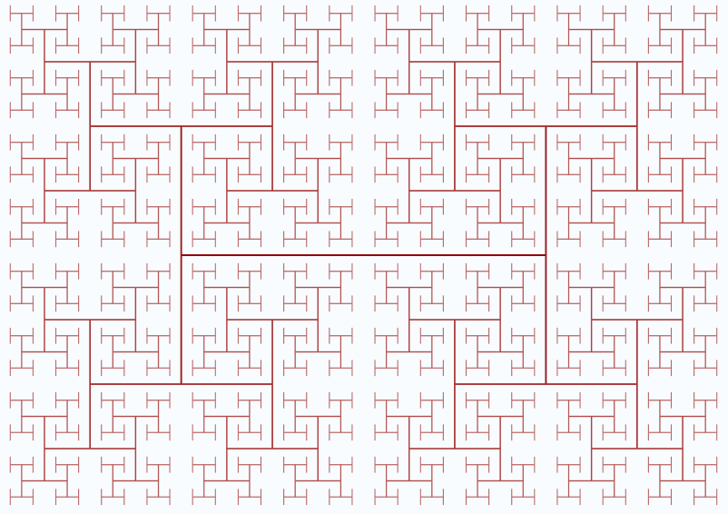

Slide 8
H-tree Form
1
2 3
4 5 6 7
8 9 a b c d e f
g h i j k l m n o p q r s t u v
i h u t
9 4 8 f 7 e
j # g v # s
2 # 1 # 3
k # n o # r
a 5 b c 6 d
l m p q

Slide 9
Hint: Pseudo-code for Printing H-tree
str[] = "123456789ABCDEFGHIJKLMNOPQRSTUV";
V[4][2] = {{-1, 0}, {1, 0}, {0, 1}, {0, -1}};
H(node, i, j, d, U, D, R, L)
{
if(node > n) return;
H_tree[i][j] = str[node-1];
if(2*node <= n) {
H_tree[i + d*V[L][0]][j + d*V[L][1]] = str[2*node-1];
H(4*node, i + d*(V[L][0]+V[U][0]),
j + d*(V[L][1]+V[U][1]), d/2, D, U, L, R);
H(4*node+1, i + d*(V[L][0]+V[D][0]),
j + d*(V[L][1]+V[D][1]), d/2, U, D, R, L);
}
if(2*node+1 <= n) {
H_tree[i + d*V[R][0]][j + d*V[R][1]] = str[2*node];
H(4*node+2, i + d*(V[R][0]+V[D][0]),
j + d*(V[R][1]+V[D][1]), d/2, U, D, R, L);
H(4*node+3, i + d*(V[R][0]+V[U][0]),
j + d*(V[R][1]+V[U][1]), d/2, D, U, L, R);
}
}
center(n) { return n <= 1 ? 0 :2 * center(n/4) + 1; }
depth(n) { return n <= 7 ? 1 : 2 * depth(n/4); }
CALL H(1, center(n), center(n), depth(n), N, S, E, W);

Slide 10
Output for Example Input
1. rotated form
5
6
2
9
3
8
4
7
1
2. not-rotated form
9
8 6
7 3 2 5
1 4
3. H-tree form
4 7 1 5
8 # 9 # 6
3 2

Slide 11
Due Date
Submission Date | Deduction Rate
December 1 | 20%
December 2 | 40%
December 3 | 60%
December 4 | 100%
Soft deadline: November 30, 2017
Hard deadline: December 3, 2017
But, will deduct 20% per one day from your original score.

Slide 12
Notice (cont’d)
You should observe the format of input & output exactly.
You should submit a compressed file (HW3_your-ID.zip) containing the following three files to the u-campus web-site (http://info.kw.ac.kr).
HW3_your-ID.hwp/doc // report document
HW3_your-ID.cpp // source code
HW3_your-ID.exe // executable file

Slide 13
Notice (cont’d)
Source code
It should be compiled in Visual Studio 2010 or higher, or g++
You should note your environment in your report.
Your name and student ID should be noted at the top of your source files in the form of comment.
Report
Free format
But, it must include several examples for testing your program and your own discussion.
It will be an important factor for getting a good score.

